Slide 1
Machine Learning

Slide 2
Machine Learning
Automating automation
Getting computers to program themselves
Writing software is the bottleneck
Let the data do the work instead!

Slide 3
Traditional Programming
Machine Learning
Data
Computer
Output
Program
Data
Computer
Program
Output

Slide 4
Why “Learn”?
Machine learning is programming computers to optimize a performance criterion using example data or past experience.
There is no need to “learn” to calculate payroll
Learning is used when:
Human expertise does not exist (navigating on Mars),
Humans are unable to explain their expertise (speech recognition)
Solution changes in time (routing on a computer network)
Solution needs to be adapted to particular cases (user biometrics)

Slide 5
What We Talk About When We Talk About“Learning”
Learning general models from a data of particular examples
Data is cheap and abundant (data warehouses, data marts); knowledge is expensive and scarce.
Example in retail: Customer transactions to consumer behavior:
People who bought “Da Vinci Code” also bought “The Five People You Meet in Heaven” (www.amazon.com)
Build a model that is a good and useful approximation to the data.

Slide 6
What is Machine Learning?
Machine Learning
Study of algorithms that
improve their performance
at some task
with experience
Optimize a performance criterion using example data or past experience.
Role of Statistics: Inference from a sample
Role of Computer science: Efficient algorithms to
Solve the optimization problem
Representing and evaluating the model for inference

Slide 7
Learning Associations
Basket analysis:
P (Y | X ) probability that somebody who buys X also buys Y where X and Y are products/services.
Example: P ( chips | cold drinks ) = 0.7
Market-Basket transactions

Slide 8
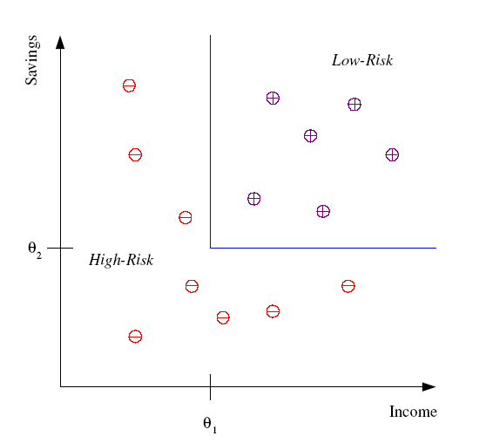
Classification
Example: Credit scoring
Differentiating between low-risk and high-risk customers from their income and savings
Discriminant: IF income > θ₁ AND savings > θ₂
THEN low-risk ELSE high-risk`
Model

Slide 9
Classification: Applications
Aka Pattern recognition
Face recognition: Pose, lighting, occlusion (glasses, beard), make-up, hair style
Character recognition: Different handwriting styles.
Speech recognition: Temporal dependency.
Use of a dictionary or the syntax of the language.
Sensor fusion: Combine multiple modalities; eg, visual (lip image) and acoustic for speech
Medical diagnosis: From symptoms to illnesses
Web Advertizing: Predict if a user clicks on an ad on the Internet.

Slide 10
ML in a Nutshell
Tens of thousands of machine learning algorithms
Hundreds new every year
Every machine learning algorithm has three components:
Representation
Evaluation
Optimization

Slide 11
Representation
Decision trees
Sets of rules / Logic programs
Instances
Graphical models (Bayes/Markov nets)
Neural networks
Support vector machines
Model ensembles
Etc.

Slide 12
Evaluation
Accuracy
Precision and recall
Squared error
Likelihood
Posterior probability
Cost / Utility
Margin
Entropy
K-L divergence
Etc.

Slide 13
Optimization
Combinatorial optimization
E.g.: Greedy search
Convex optimization
E.g.: Gradient descent
Constrained optimization
E.g.: Linear programming

Slide 14
Types of Learning
Supervised (inductive) learning
Training data includes desired outputs
Unsupervised learning
Training data does not include desired outputs
Semi-supervised learning
Training data includes a few desired outputs
Reinforcement learning
Rewards from sequence of actions

Slide 15

Supervised Learning
In Supervised learning, you train the machine using data which is well "labelled."
It means some data is already tagged with the correct answer.
It can be compared to learning which takes place in the presence of a supervisor or a teacher.

Slide 16
Supervised Learning
A supervised learning algorithm learns from labelled training data, helps you to predict outcomes for unforeseen data.
Example: Is it a cat or a dog?
Image classification is a popular problem in the computer vision field. Here, the goal is to predict what class an image belongs to. In this set of problems, we are interested in finding the class label of an image. More precisely: is the image of a car or a plane? A cat or a dog?

Slide 17
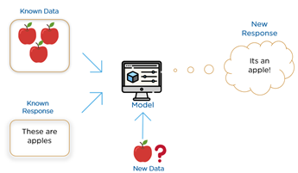
Supervised Learning

Slide 18
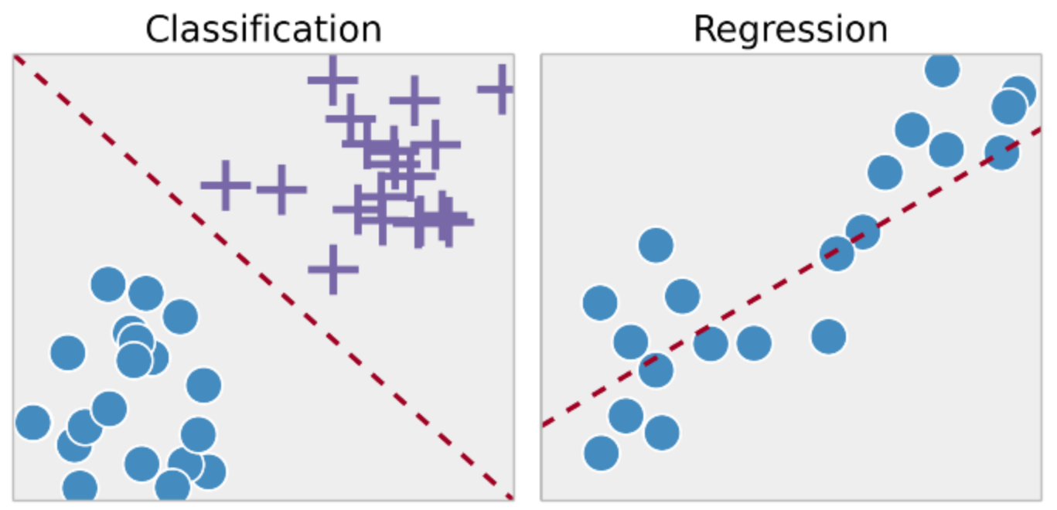
Types of Supervised Learning

Slide 19
Types of Supervised Learning - Classification
In machine learning, classification refers to a predictive modelling problem where a class label is predicted for a given example of input data.
Examples of classification problems include:
Given an example, classify if it is spam or not.
Given a handwritten character, classify it as one of the known characters.
Given recent user behaviour, classify as churn or not.

Slide 20
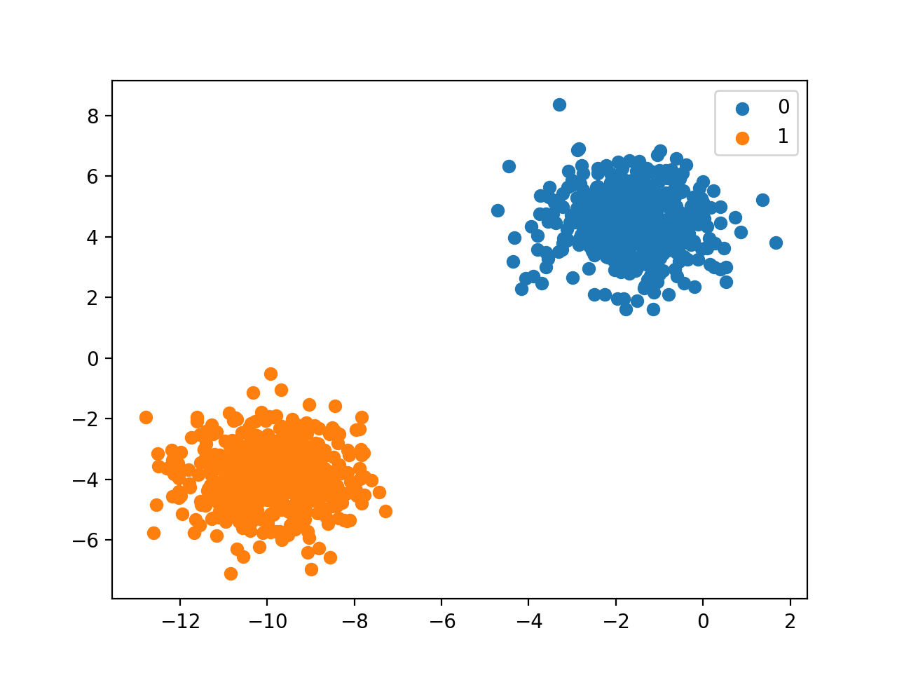
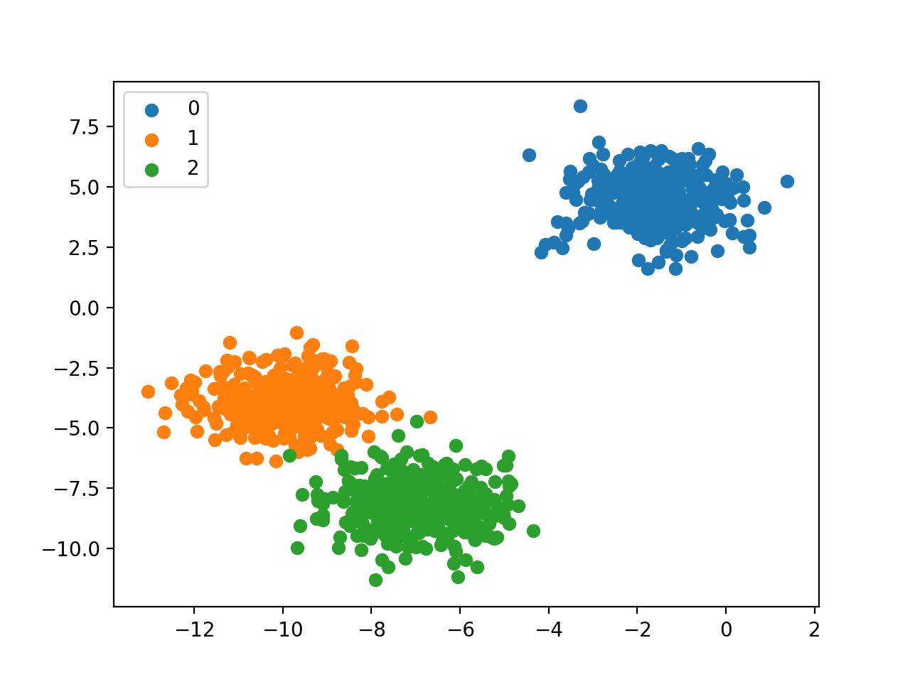
Types of Supervised Learning - Classification
Binary Classification
Multi-Class Classification
Examples include:
Email spam detection (spam or not).
Churn prediction (churn or not).
Conversion prediction (buy or not).
Examples include:
Face classification.
Plant species classification.
Optical character recognition.

Slide 21
Types of Supervised Learning - Regression
Regression analysis consists of a set of machine learning methods that allow us to predict a continuous outcome variable (y) based on the value of one or multiple predictor variables (x).
Briefly, the goal of regression model is to build a mathematical equation that defines y as a function of the x variables.

Slide 22
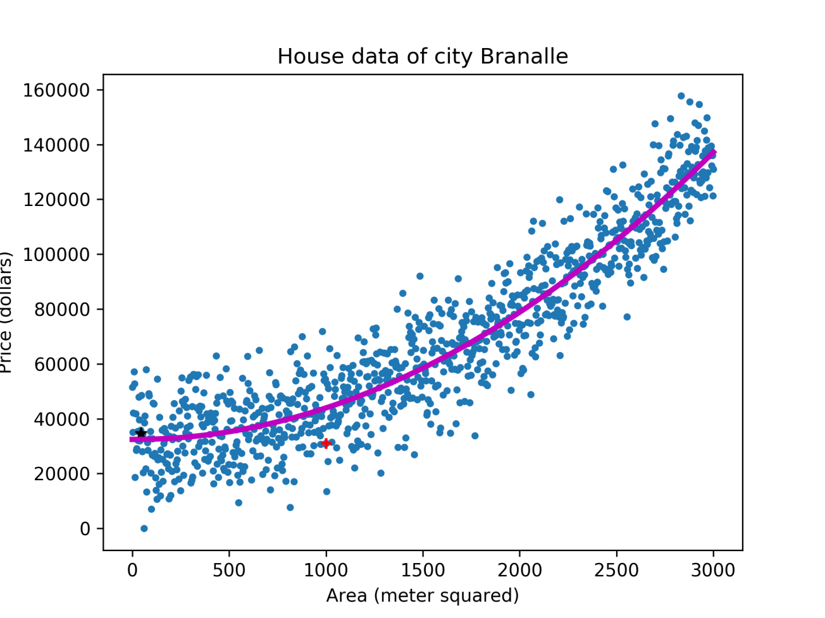
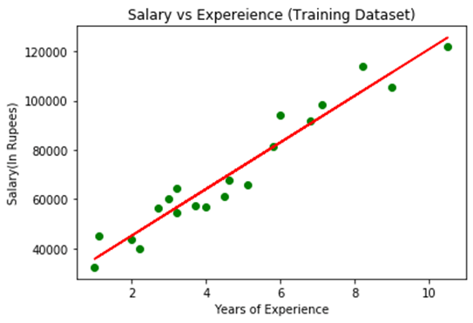
Types of Supervised Learning - Regression

Slide 23
Un-supervised Learning
Unsupervised learning is a machine learning technique, where you do not need to supervise the model.
Instead, you need to allow the model to work on its own to discover information.
It mainly deals with the unlabelled data.

Slide 24
Un-supervised Learning
Unsupervised learning algorithms allow you to perform more complex processing tasks compared to supervised learning.
For example, you will able to determine the time taken to reach back come base on weather condition, Times of the day and holiday.

Slide 25
Types of Unsupervised Learning - Clustering
Clustering, is an unsupervised machine learning task.
It involves automatically discovering natural grouping in data.
Unlike supervised learning (like predictive modelling), clustering algorithms only interpret the input data and find natural groups or clusters in feature space.

Slide 26
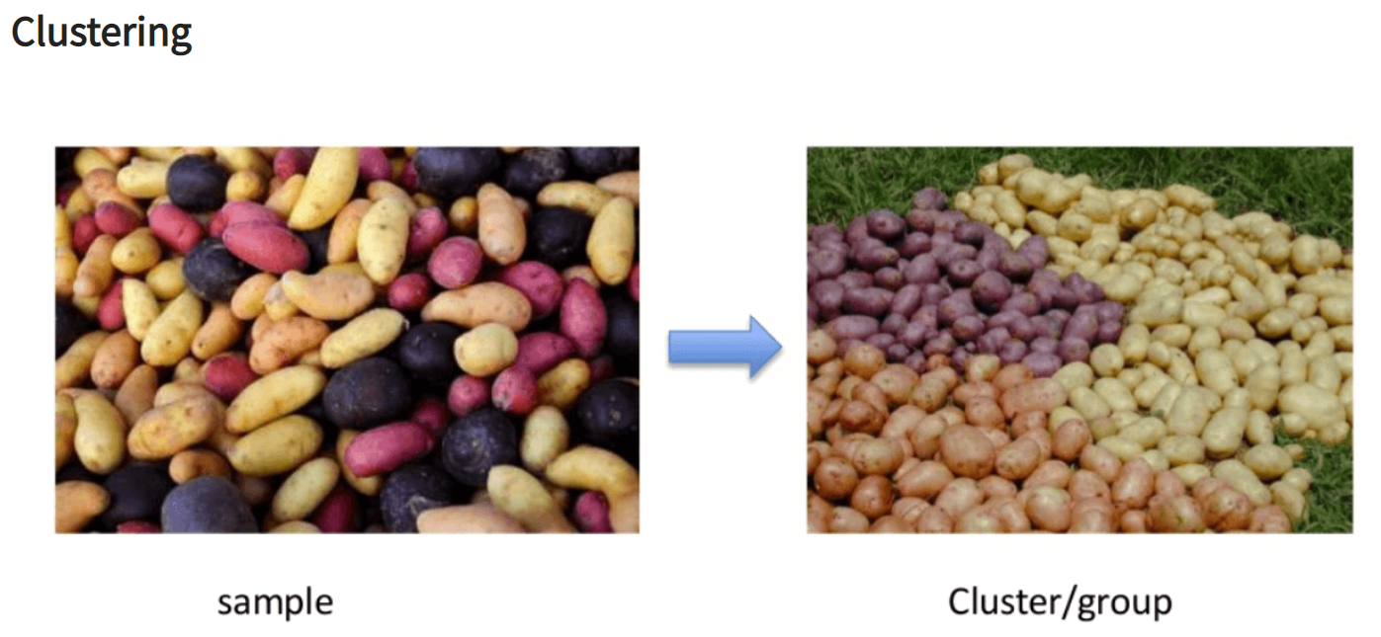
Types of Unsupervised Learning

